Slide 1
AUTOMATED PLANT IDENTIFICATION
NAME: GOWRI G
REG NO: 2019202013
MCA-R(FINAL YEAR)
GUIDE NAME: DR.L.SAIRAMESH

Slide 2
OBJECTIVE
To introduce plant expert determination
To identifying plant Recognition and comparison
To frame RGB to Gray scale images
To begin to identify plants using Artificial Neural Network(ANN)

Slide 3
INTRODUCTION
MACHINE LEARNING:
Machine Learning teaches computers to do what comes naturally to humans, learn from experience. Machine learning algorithms use computational methods to learn information directly from data without replying on a predetermined equation as a model. The algorithms adaptively improve their performance as the number of samples available for learning increases.

Slide 4
Literature Review
S.NO | Author Name and Paper Title | Concept in the paper | Paper details
1 | Author : Taylor & Francis Group Title : Automated plant identification using artificial neural network and support vector machine | Algorithm : Artificial neural network(ANN) and Support vector machine(SVM) | Automated identification techniques of plant leaf based on herbarium leaf images, using the pattern recognition approach. Two machine learning algorithms: ANN and SVM have been used to build identification models. Both models achieved satisfactory results demonstrating their usefulness in identification tasks.

Slide 5
ABSTRACT
Since there are many classifications of herbal plants, it becomes time consuming and less accurate when predicted by the non-professionals.
Three main steps that are image pre-processing, feature extraction and recognition were carried out to develop the proposed system.
This system can be implemented by using the jupyter notebook. Machine learning concepts drastically decrease the time needed to arrange an exact map. In this project we will be using Artificial Neural Network (ANN) Algorithm for classification.

Slide 6
PROBLEM STATEMENT
Plants are the backbone of life on earth, as it provides us food and oxygen. Hence, A good understanding of plants is needed to help in identifying new or rare plant species.
Recognition of Plant from images is a challenging computer vision task.
The various types of challenges are many parts of the plant, which need to be identified, are also diverse in nature with high intra class variations and small inter class variations.

Slide 7
Implementation Framework
Development Platform : jpyter Notebook
Language : Python

Slide 8
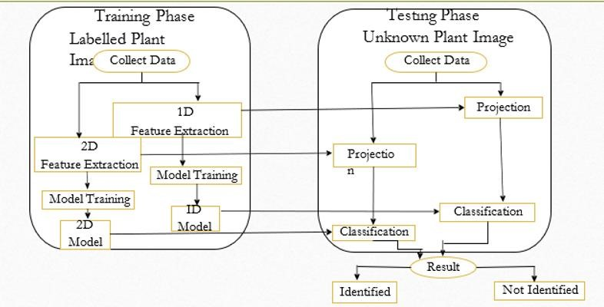
Architecture Diagram

Slide 9
List of Modules
Image acquisition:
Sample images in the study consist of many plant image structure.
Young leaves that are evidently small sized were ignored. Selected leaves were cropped out and saved as new images with a standard resolution
Image Pre-processing:
Since all leaves are not perfectly flat, image capturing would always cast a shadow underneath the leaf.
The shadow would disrupt the edge detection as it has a huge contrast with the background, confusing the algorithms to draw the boundary based on shadow instead of on the leaf.

Slide 10
Segmentation:
The image to obtain a binary image separating the leaf from the background.
We do this by estimating foreground and background colour distributions in the saturation-value space of the HSV colour space.
Feature Extraction:
Processed images from previous steps were transformed into a set of parameters that describe the leaf features.
There are four classes of features extracted in this study: morphological features
(shape), texture features and histogram of oriented gradients

Slide 11
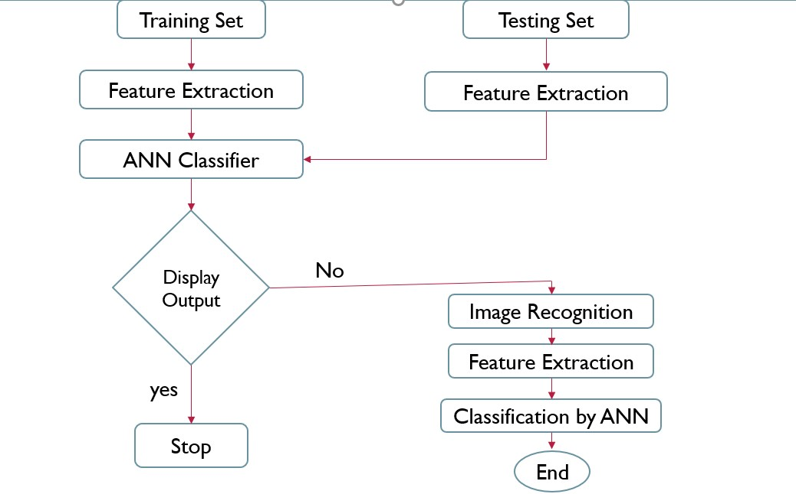
Classification:
ANN was developed using a multilayer perceptron network to train and classify the extracted features values into three classes representing the three species used in this study, data samples were divided into training and testing sets.

Slide 12
Ann Algorithm
Steps in ANN implementation:
Step1: start.
Step2: Read the dataset.
Step3: Label the data if necessary.
Step4: Split the data for train (75%) and test (25%).
Step5: Train the data. Step6: After trained the data successfully, Test the data.
Step7: Train and evaluate the model
Step8: End

Slide 13

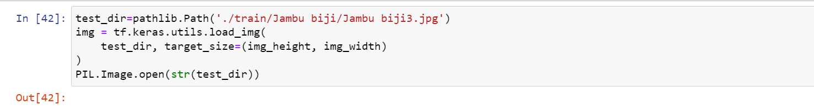
Output
Accuracy:

Slide 14
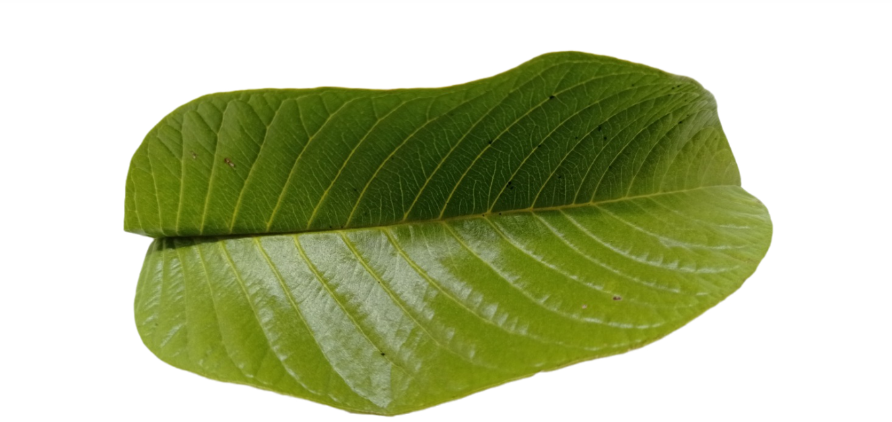
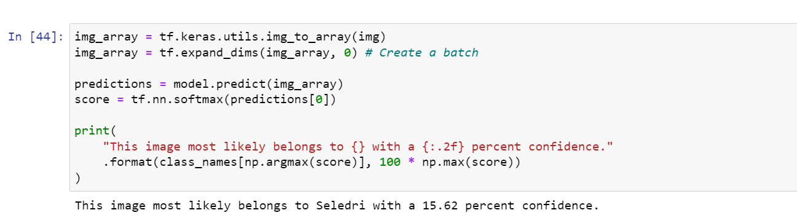

Slide 15
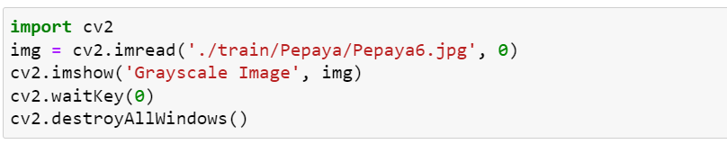
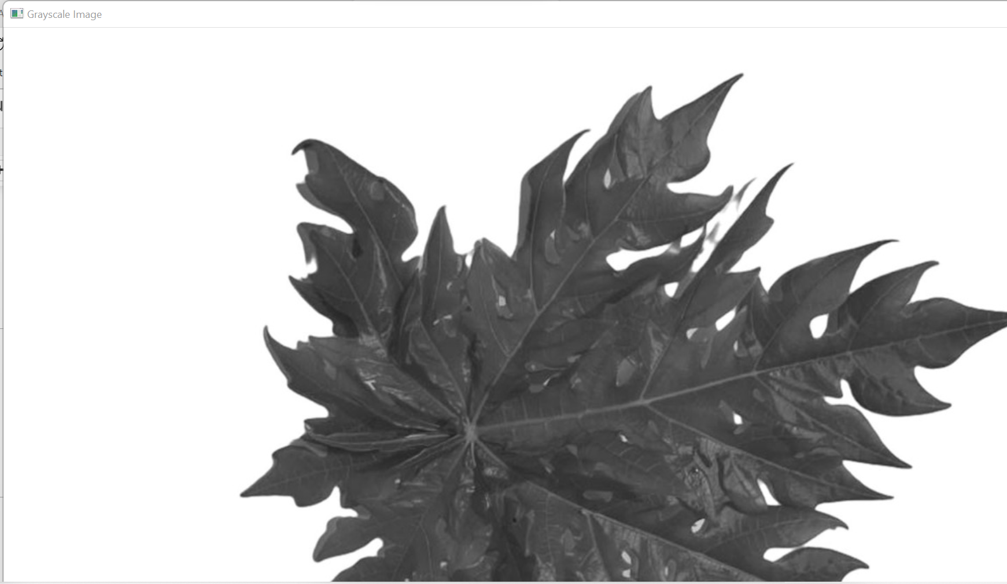
Image Convert gary scale(text Feature)

Slide 16
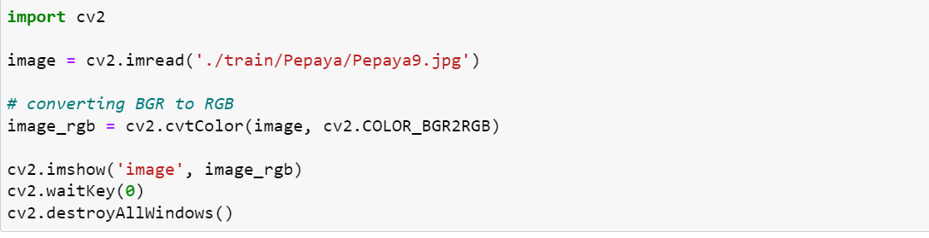

(COLOUR FEATURE)

Slide 17
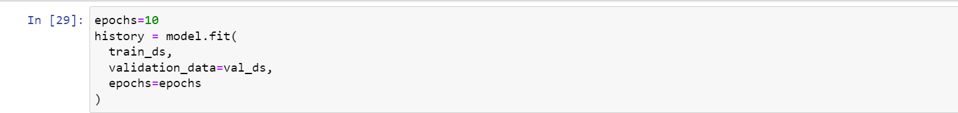
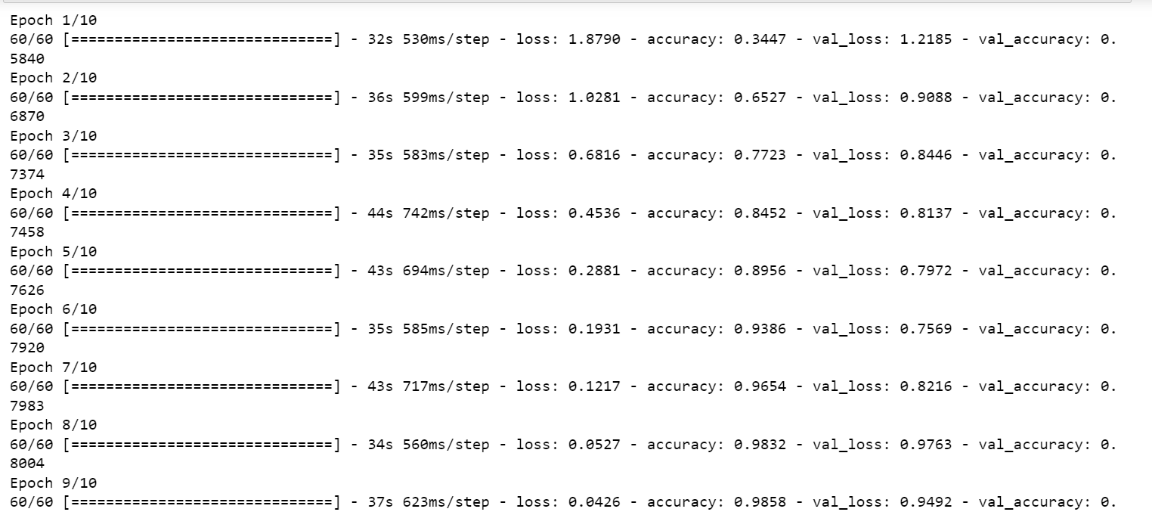
Training Analysis

Slide 18
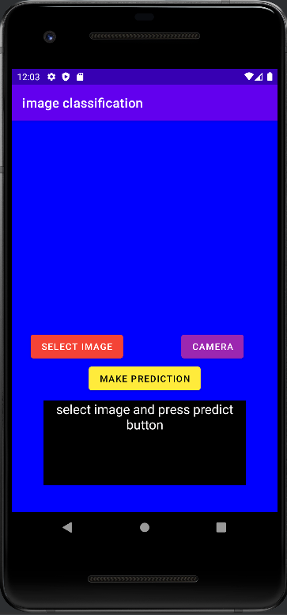
Leaf Identification App:

Slide 19
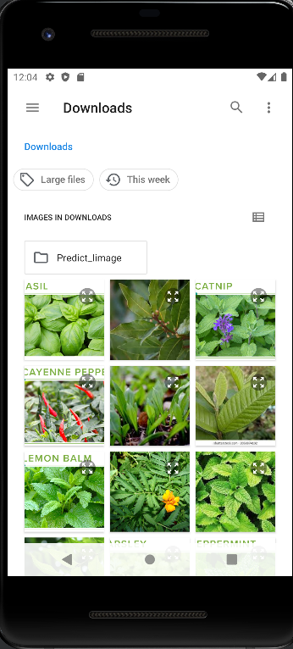
Select the Image:

Slide 20
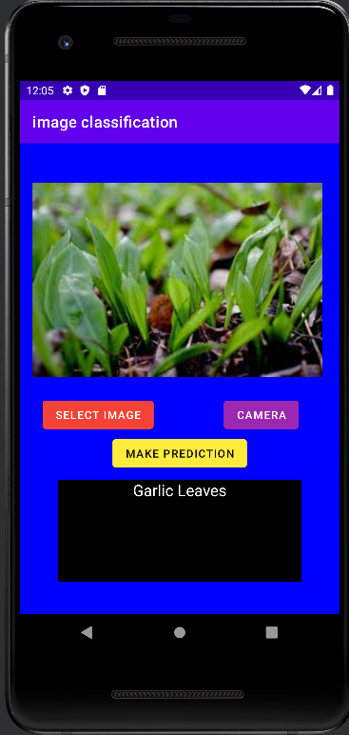
Predict the image

Slide 21
REFERENCES
Soon Jye Kho, Sukumaran Manickam, Soraya Malek, Mogae Musleh & Surinder Kaur Dhillon (2017) Automated plant identification using artificial neural network and support vector machine, Frontiers in Life Science, 10:1, 98-107, DOI: https://doi.org/10.1080/21553769.2017.1412361
Adel Bakhshipoua , Abdolabbas Jafari, Evaluation of support vector machine and artificial neural networks in weed detection using shape features, Received 25 January 2017; Received in revised form 20 December 2017; Accepted 22 December 2017, https://doi.org/10.1016/j.compag.2017.12.032
Liwen Gao, Xiaohua Lin, Fully segmentation method for medicinal plant leaf images in complex background , Received 28 March 2019; Received in revised form 18 July 2019; Accepted 23 July 2019, Available online 30 July 2019, https://doi.org/10.1016/j.compag.2019.104924

Slide 22
THANK YOU

